Slide 1
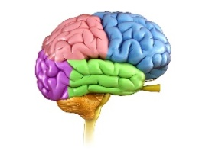
University of Basrah
Al-Zahraa Medical College
Ministry of higher Education and Scientific Research
Nervous System Module
Academic Year 2021-2022
3rd year S6
Session:2 Lecture: 1
Cellular Physiology of the Brain (Neurons & Glial cells)
Module staff:
Dr. Mohammed Yas Mohammed
Dr. Nehaya Mnahi Al_Aubody
Dr. Wisam Abdullah Jasim
Dr. Ahmed Badr
Dr. Ansam Munadhel Hussein
Dr. Ali Majeed

Slide 2
Learning objectives
Name the types of Glial cells found in the central nervous system and describe their roles.
Describe the structure and function of the blood brain barrier.
Describe the general morphology of a neuron and how neurotransmitters are released.
Name the major excitatory and inhibitory neurotransmitters in the central nervous system and describe their action at receptors.
Name the major amine neurotransmitters, understand that they are located in discrete pathways, are implicated in various CNS disorders and are major targets for CNS drugs.

Slide 3
NEUROGLIA TYPES:
Glial cells (Neuroglia) :
They are highly branched cells which occupy the spaces between the neurones and they are four
Oligodendrocytes
Microglia
Ependymal cells
Astrocytes
LO1
Notes:
1-Astrocytes :
Are star-shaped cells, their processes are often in contact with a blood vessels .
Play role in :
Maintain blood-brain barrier .
Provide structural support .
Regulate ion, nutrient, and dissolved gas concentration .
Absorb and recycle neurotransmitters .
Form scar tissue after injury .
2-Oligodendrocytes :
Are smaller than the astrocytes , with fewer and shorter processes
They are found in both grey and white matter of CNS .
Play role in :
A- Myeline sheath production of the CNS axons .
B-Provide structural framework .
3- Microglia :
These are small cells, with elongated bodies, elongated nuclei and few processes. They are found in both
the grey and white matter of the CNS .
Play role in :
A-Immune defence remove cell debris , wast and pathogens by phagocytosis .
4-Ependymal cells :
The ependyma is composed of neuroglia that lining the internal cavities (ventricle) of brain and the central canal of the spinal cord .
They are cuboidal ciliated epithelium .
The ependymal cells are bathed in cerebrospinal fluid (CSF).
Play role in :
A-Lining ventricles of brain & cenral canal of the spinal cord .
B-Assist in producing , circulating and monitoring of CSF .

Slide 4
NEUROGLIA FUNCTIONS:
Oligodendrocytes smaller than the astrocytes , with fewer and shorter processes
Microglia :
Ependymal cells :
Astrocytes :
star-shaped cells, their processes are often in contact with a blood vessels .
Play role in :
Maintain blood-brain barrier .
Provide structural support .
Regulate ion, nutrient, and dissolved gas concentration .
Absorb and recycle neurotransmitters .
Form scar tissue after injury .
found in both grey and white matter of CNS .
Play role in :
A- Myeline sheath production of the CNS axons .
B-Provide structural framework .
These are small cells, with elongated bodies, elongated nuclei and few processes. They are found in both
the grey and white matter of the CNS .
Play role in :
Composed of neuroglia that lining the internal cavities (ventricle) of brain and the central canal of the spinal cord .
bathed in cerebrospinal fluid (CSF).
Play role in :
B-Assist in producing , circulating and monitoring of CSF .
Immune defence remove cell debris , wast and pathogens by phagocytosis .
A-Lining ventricles of brain & cenral canal of the spinal cord .
LO1
Notes:
1-Astrocytes :
Are star-shaped cells, their processes are often in contact with a blood vessels .
Play role in :
Maintain blood-brain barrier .
Provide structural support .
Regulate ion, nutrient, and dissolved gas concentration .
Absorb and recycle neurotransmitters .
Form scar tissue after injury .
2-Oligodendrocytes :
Are smaller than the astrocytes , with fewer and shorter processes
They are found in both grey and white matter of CNS .
Play role in :
A- Myeline sheath production of the CNS axons .
B-Provide structural framework .
3- Microglia :
These are small cells, with elongated bodies, elongated nuclei and few processes. They are found in both
the grey and white matter of the CNS .
Play role in :
A-Immune defence remove cell debris , wast and pathogens by phagocytosis .
4-Ependymal cells :
The ependyma is composed of neuroglia that lining the internal cavities (ventricle) of brain and the central canal of the spinal cord .
They are cuboidal ciliated epithelium .
The ependymal cells are bathed in cerebrospinal fluid (CSF).
Play role in :
A-Lining ventricles of brain & cenral canal of the spinal cord .
B-Assist in producing , circulating and monitoring of CSF .

Slide 5
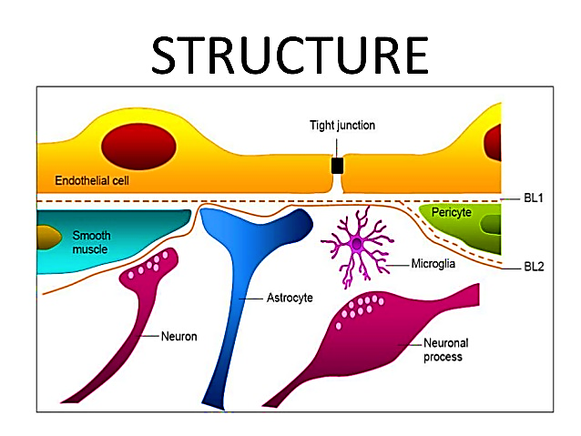
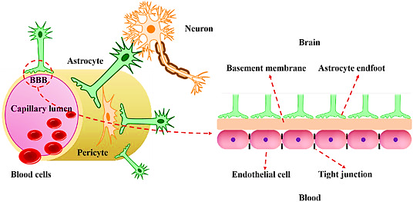
LO2
Blood Brain Barrier (BBB)
Is a unique membranous barrier that separates the circulating blood from brain extracellular fluid (BECF) in the CNS with high selectivity.

Slide 6
LO2
Blood Brain Barrier (BBB)
In the brain, endothelial cells are packed much tighter together, blocking the passage of all molecules except
1- lipid soluble substances (such as oxygen, carbon dioxide, ethanol, and steroid hormones)
2- Those that are allowed in by specific transport systems (such as sugars and some amino acids).
• Substances with a molecular weight higher than 500 Daltons generally cannot cross

Slide 7
BBB v/s capillaries of peripheral nerve
LO2
 | BBB | capillaries of peripheral nerve
Fenestration/clefts | no | yes
Vesicular transport | deficient | abundant
Pinocytic vesicles | rare | abundant
Tight junction | ++++++ | +
Selective transport | ++++++ | +
Astrocyte foot process | ++++++ | +

Slide 8
LO2
BBB v/s capillaries of peripheral nerve
Tight junction between endothelial cells
No macrovesicles for microvascular transport
Thick basement membrane
Astrocytic end-feet (Projections from Astrocytes)

Slide 9
Functions of BBB (Dual function Barrier and carrier)
LO2
Endothelial junction restricts the movement of water-soluble substance
Enzymatic barrier : (protection)
Different enzymes like Ach-esterase , alkaline phosphatase ,Gama glutamate transpeptidase, monoamine oxidase and other drug metabolizing enzyme capable to damage the CNS
Ion regulation :
concentration of [K+] in mammalian plasma is approximately 4.5 mM, but in CSF and brain ISF –> ∼2.5–2.9 mM, in spite of changes that can occur in plasma [K+] following exercise or a meal, imposed experimentally, or resulting from pathology.
Stable environment for neural function
combination of specific ion channels and transporters keeps the ionic composition optimal for synaptic signaling function.
Ca2+, Mg2+ and pH are also actively regulated at the BBB and BCSFB
Holder : it holds the neurotransmitters within CNS
Protection : protect the CNS from toxin

Slide 10
Circumventricular Areas :
are a group of structures lacking a blood-brain barrier that are centered around the ventricles of the brain.
Functions of BBB
Carrier FUNCTION
LO2
LO2
The blood-brain barrier (BBB) possesses various carrier-mediated transport systems for small molecules to support and protect CNS function. For example, the blood-to-brain influx transport systems supply nutrients, such as glucose and amino acids.
Sensory organs
Secretory organs
Subcommissural organ function secretion of the glycoprotein is thought to contribute to the maintenance of the patency of the sylvian aqueduct.
Vascular organ of the lamina terminalis VOLT) situated in the anterior wall of the third ventricle Function responsible for the homeostatic conservation of osmolarity.
subfornical organ (SFO) fornix osmoregulation cardiovascular regulation and energy homeostasis
Pituitary gland
Median eminence (ME) hypothalamus and third ventricle. function transport of neurohormons between the CSF and the peripheral blood supply
Pineal gland diencephalon and third ventricle function its secretion of the hormone melatonin .
Area postrema medulla oblongata Function chemoreceptor trigger zone for vomiting

Slide 11
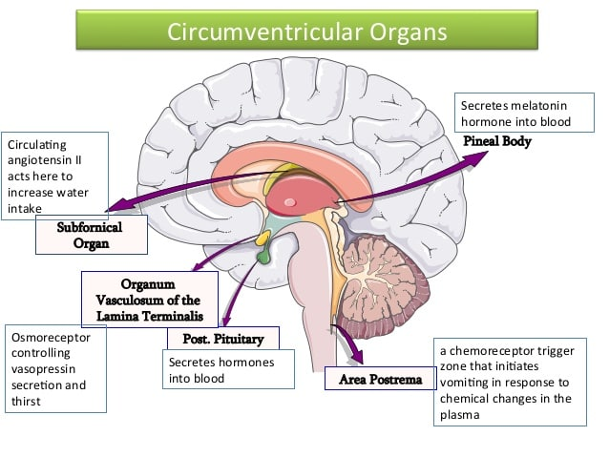
LO2

Slide 12
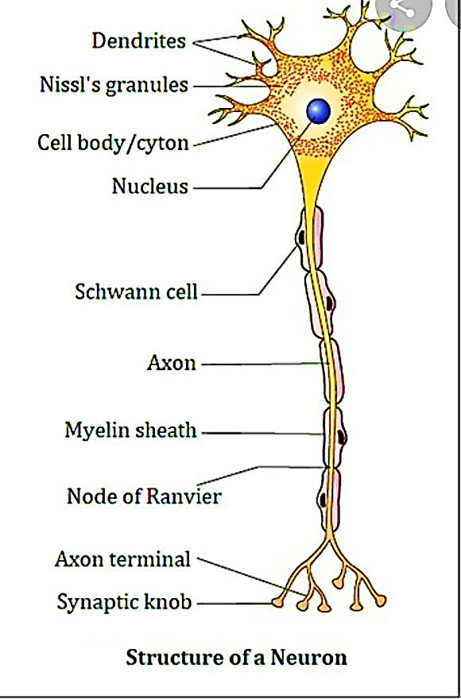
General Morphology of Neurone
1-The cell body (perikaryon) is the large part of the neuron containing the nucleus and cytoplasm Within the cytoplasm are granules called Nissl bodies which are aggregations of rough endoplasmic reticulum .
2-The axon is a single process specialised in conducting nerve impulses away from the cell body to other cells. Its initial segment called Axon hillock where AP start.
3-Dendrites are multiple elongated processes specialised for receiving stimuli from the environment (sensory organs) or other neurones and conducting them to wards the cell body.
LO3

Slide 13
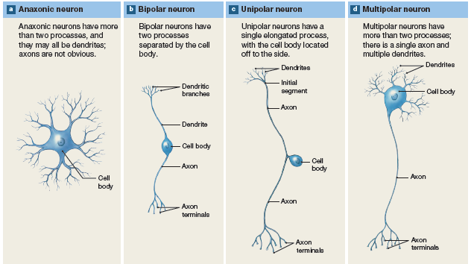
Morphological Classification of Neurons:

Slide 14
Neurotransmitters:
LO4
Chemical endogenous messengers that carry, boost, and balance signals between neurons and other cells in the body.
They can affect a wide variety of both physical and psychological functions including heart rate, sleep, appetite, mood, and fear.
Billions of neurotransmitter molecules work constantly to keep our brains functioning
Managing everything from our breathing to our heartbeat to our learning and concentration levels
Why are they called Neurotransmitter? Where are their action?

Slide 15
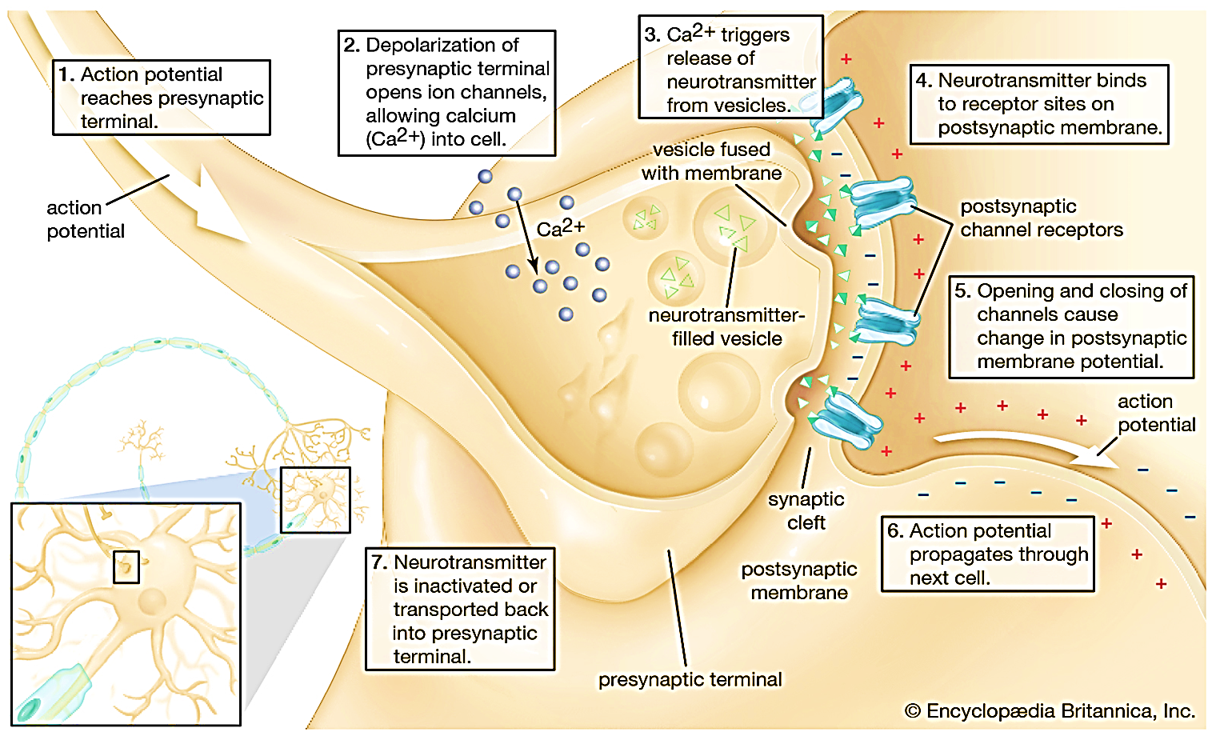
Seven processes in neurotransmitters action :
LO4

Slide 16
Types of Neurotransmitters:
LO4

Slide 17
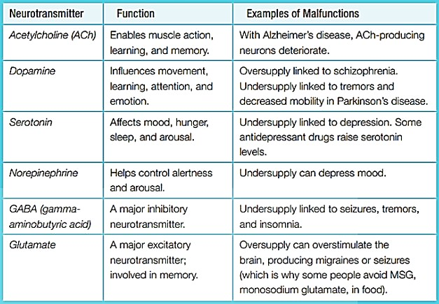
LO4

Slide 18
LO5
Amine Neurotransmitters:
the three catecholamines—dopamine, norepinephrine (noradrenaline), and epinephrine (adrenaline)—and histamine and serotonin.
Their synthesis is from……????

Slide 19
LO5

Slide 20
Acetylcholine:
LO5
Low levels of acetylcholine are linked with issues with memory and thinking, such as those that affect people with Alzheimer disease.
Some Alzheimer's medications help slow the breakdown of acetylcholine in the body, and this can help control some symptoms, such as memory loss.
High levels of acetylcholine can cause too much muscle contraction. This can lead to seizures, spasms, and other health issues.

Slide 21
Dopamine:
LO5
Dopamine is synthesized in three steps from the amino acid tyrosine
Is important for memory, learning, behavior, and movement coordination.
Many people know dopamine as a pleasure or reward neurotransmitter. The brain releases dopamine during pleasurable activities.
Dopamine is also responsible for muscle movement. A dopamine deficiency can cause Parkinson’s disease.
Schizophrenics have too much dopamine.

Slide 22
Norepinephrine:
LO5
Synthesized directly from dopamine.
It is synthesized in four steps from tyrosine.
It is Synthesis occurs within vesicles.
It is a direct precursor to epinepherine.
Norepinephrine is strongly associated with bringing our nervous systems into "high alert."
It increases our heart rate and our blood pressure.
It is also important for forming memories.

Slide 23
Epinephrine:
LO5
is involved in the body's "fight or flight" response. It is both a hormone and a neurotransmitter……????
Release when a person is stressed or scared ,increases heart rate and breathing and gives the muscles a jolt of energy. It also helps the brain make quick decisions in the face of danger.
While epinephrine is useful if a person is threatened, chronic stress can cause the body to release too much of this hormone. Over time, chronic stress can lead to health problems such as decreased immunity, hypertension , DM, and heart disease.

Slide 24
Glutamate:
LO5
It is an amino acid
It is the most commonly found excitatory neurotransmitter in the brain.
It is involved in most aspects of normal brain function including cognition, memory and learning.
Glutamate is formed from α – ketoglutarate, an intermediate of Kreb’s cycle.

Slide 25
GABA “Gamma-aminobutyric acid”:
LO5
Present in high concentrations in the CNS
Is a mood regulator. It has an inhibitory action, which stops neurons from becoming overexcited. This is why low levels of GABA can cause anxiety, irritability, and restlessness.
If GABA is lacking in certain parts of the brain, epilepsy results.
Benzodiazepines, or "benzos," are drugs that can treat anxiety. They work by increasing the action of GABA. This has a calming effect that can treat anxiety attacks.

Slide 26
Serotonin:
LO5
Is an inhibitory neurotransmitter
Synthesized in two steps from the amino acid tryptophan
Regulates attention and other complex cognitive functions, such as sleep (dreaming), eating, mood, pain regulation. blood clotting, and the body's circadian rhythm.
Too little serotonin has been shown to lead to depression. Selective serotonin reuptake inhibitors drugs, or SSRIs, can relieve depression by increasing serotonin levels in the brain.
lower levels of serotonin linked to Seasonal affected disorder (SAD) causes symptoms of depression in the fall and winter, when daylight is less abundant……?????

Slide 27
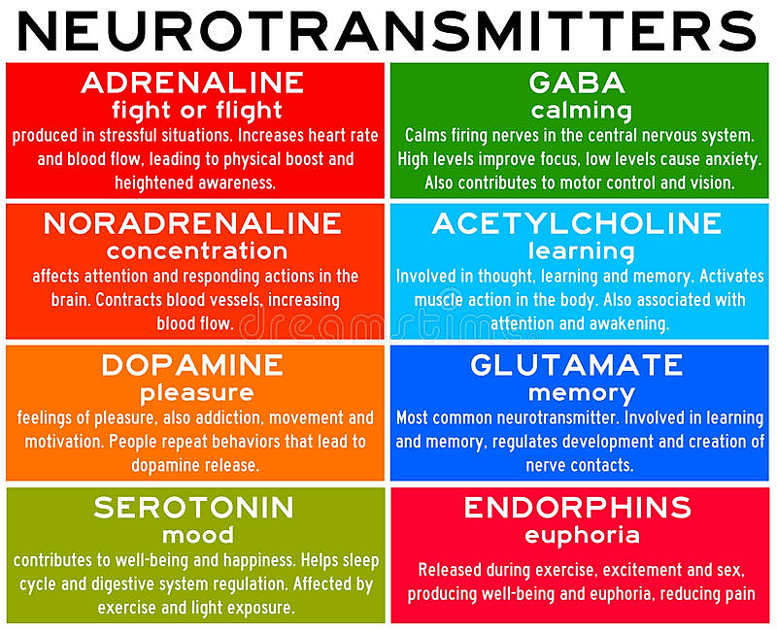
LO5

Slide 28
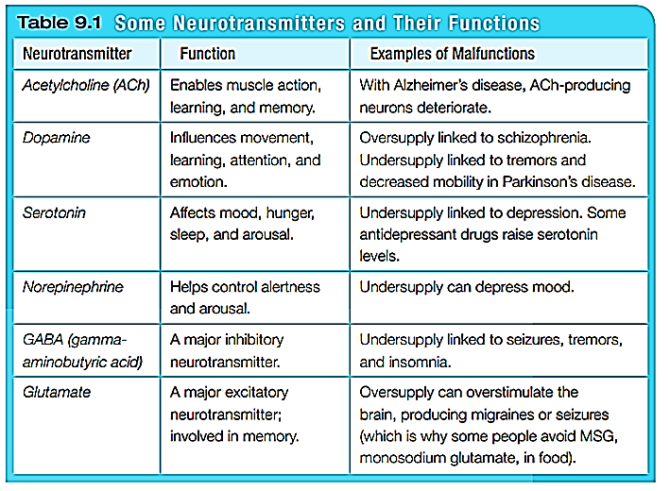
LO5

Slide 29
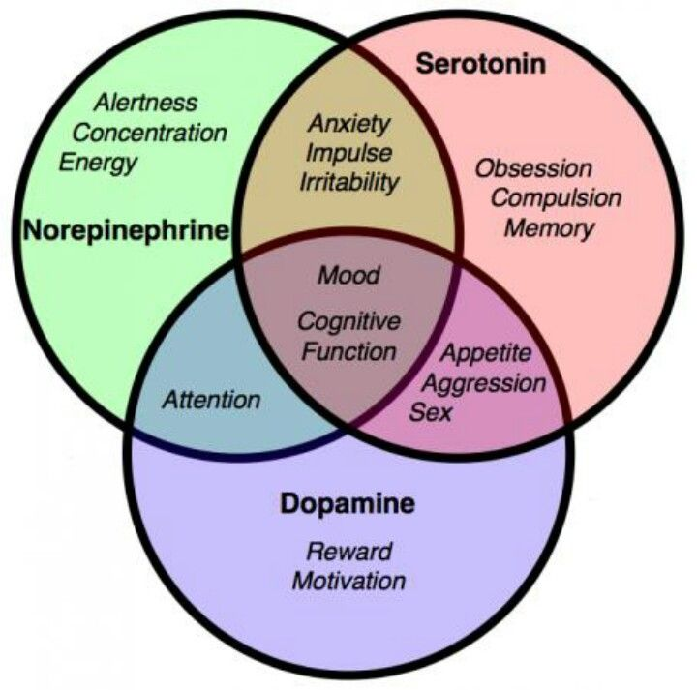
Amine Neurotransmitters
LO5

Slide 30
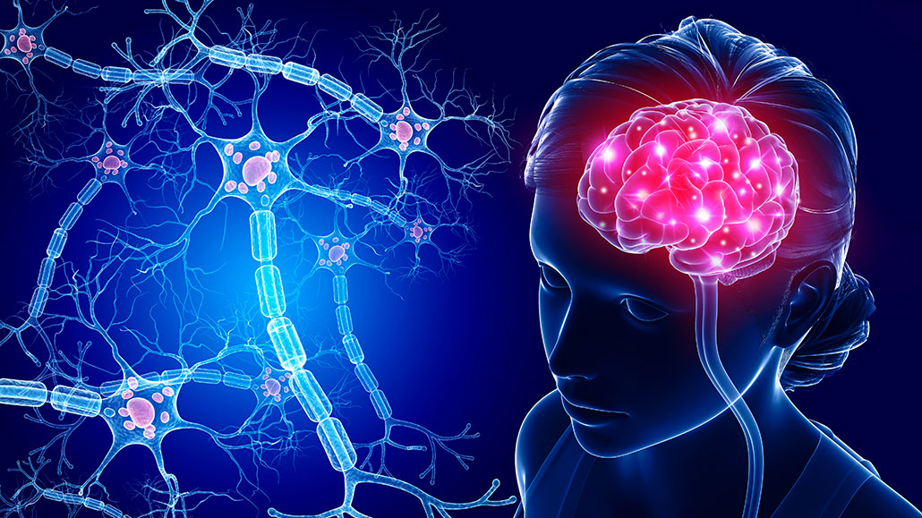
THANK YOU

